Slide 1
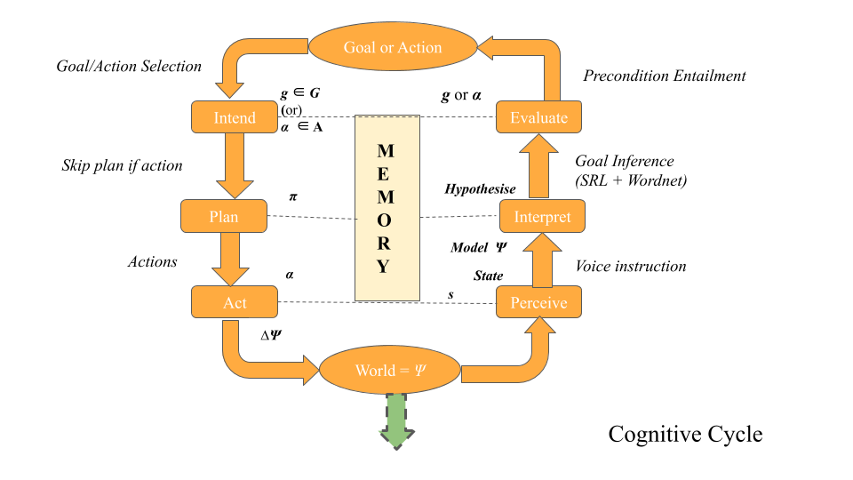


#poster-gotteti
Overview: Towards Goal Inference for Human-Robot Collaboration
Shree Gotteti(GOTTETI.2@WRIGHT.EDU), Matthew Molineaux, and Michael Cox
Collaboration through NL is most intuitive.
NL utterances often leave the user intent unspecified or underspecified.
We propose a novel Goal Inference Procedure infers the intent of the user using natural language processing techniques.
Our model extracts the semantic representation of an utterance using Synonym generation/filtration and Semantic Role Labeling (SRL).
Operationalizable actions/goals are inferred by analyzing the task domain.
Our procedure has been integrated with the cognitive cycle of MIDCAⁱ.
Our model plans on improving the flexibility (handle freeform utterances) of their interactions.
Further details on implementation, usage examples, and limitations are provided during the discussion. (Room #3: https://zoom.us/j/2418841790)
A conceptual model of the Goal Inference Model integrated with Cognitive Cycle of MIDCA.
i Cox et al., 2016.
Eighth Annual Conference on Advances in Cognitive Systems, 2020.

Slide 2
ACS 2020
#poster-gotteti
Towards Goal Inference for Human-Robot Collaboration
Shree Gotteti¹(GOTTETI.2@WRIGHT.EDU), Matthew Molineaux²(MATTHEW.MOLINEAUX@WRIGHT.EDU), and Michael Cox²( MICHAEL.COX@WRIGHT.EDU).
Human-Robot Collaboration requires the agents to communicate, to achieve a goal or an action.
Communication can be verbal (natural language) and/or nonverbal (sign language).
Natural language utterances often leave the intent of the user unspecified.
In order to decide what action or goal to achieve based on a user utterance, the agent requiresⁱ:
An understanding of natural language
Semantic representation of an instruction. e.g: operator (list of semantic arguments)
Domain-specific Groundings (physical world representation)
Different approaches to understand the motives and intent haven been developed based on:
Types of Spoken Dialogue Systemsⁱⁱ
learning based systemsⁱⁱⁱ
systems that deal with indirect speech actsⁱ
v
i. Tellex et al., 2020; Mavridis, 2015; Alomari, 2017.
ii. Spiliotopoulos, 2013.
iii. Laird, 2017; Scheutz, 2018
iv. Wilske & Kruijff, 2006; Briggs & Scheutz, 2017
1
2
Acknowledgement of graduate fellowship at Wright State University for first author.
Notes:
Title: Towards Goal Inference
Authors:
Funding:
perceived by a cognitive agent either in voice or text form.
Motivation
Human Robot Collaboration through language
Several methods [......] have been proposed for this purpose
Yet, What do they really mean?

Slide 3
ACS 2020
#poster-gotteti
Goal Inference Model
Most of the approaches are engineered specific to a domain and/or task (e.g: Mavridis, 2015; Tellex et al., 2020).
Our model intends to handle:
Unique & freeform utterances (domain-generality)
Infer operationalizable actions/goals from them
Synonym generation and Semantic Role Labeling(SRL) are utilized to obtain semantic representation of an utterance.
Extracted information is used to obtain domain-specific mappings
Goal/Action Inference is done through condition checks.
Our model has been integrated with Metacognitive Integrated Dual Cycle Architecture(MIDCA).
A conceptual model of the Goal Inference Model integrated with Cognitive Cycle of MIDCA.
Towards Goal Inference for Human-Robot Collaboration

Slide 4
ACS 2020
#poster-gotteti
Synonym Generation/Filtration & Semantic Arguments to Groundings
Synonym Generation & Filtration:
Wordnet to generate sets of synonyms for domain-specific keywords. (operators, and predicates)
Some Filtration process is required to eliminate words that have no meaning in the domain of discourse.
Refined set is our knowledge base for the agent.
Utterance: “place the red block on the green block.”
Semantic Arguments to Groundings:
Get Predicate Argument Structure (PAS)using SRL
PAS:V: “place” A1: “the red block” A2: “on the green block”
Extract Domain-specific operator o: stack (most synonymous to place).
Extract Domain-specific Mapping ⇒ o: stack, objects: [(block, red), (block, green)]
Check if operator extracted is in domain-specific keywords
⇒ Is it a goal or an action?
Towards Goal Inference for Human-Robot Collaboration
Notes:
Consider example domain as construction domain.

Slide 5
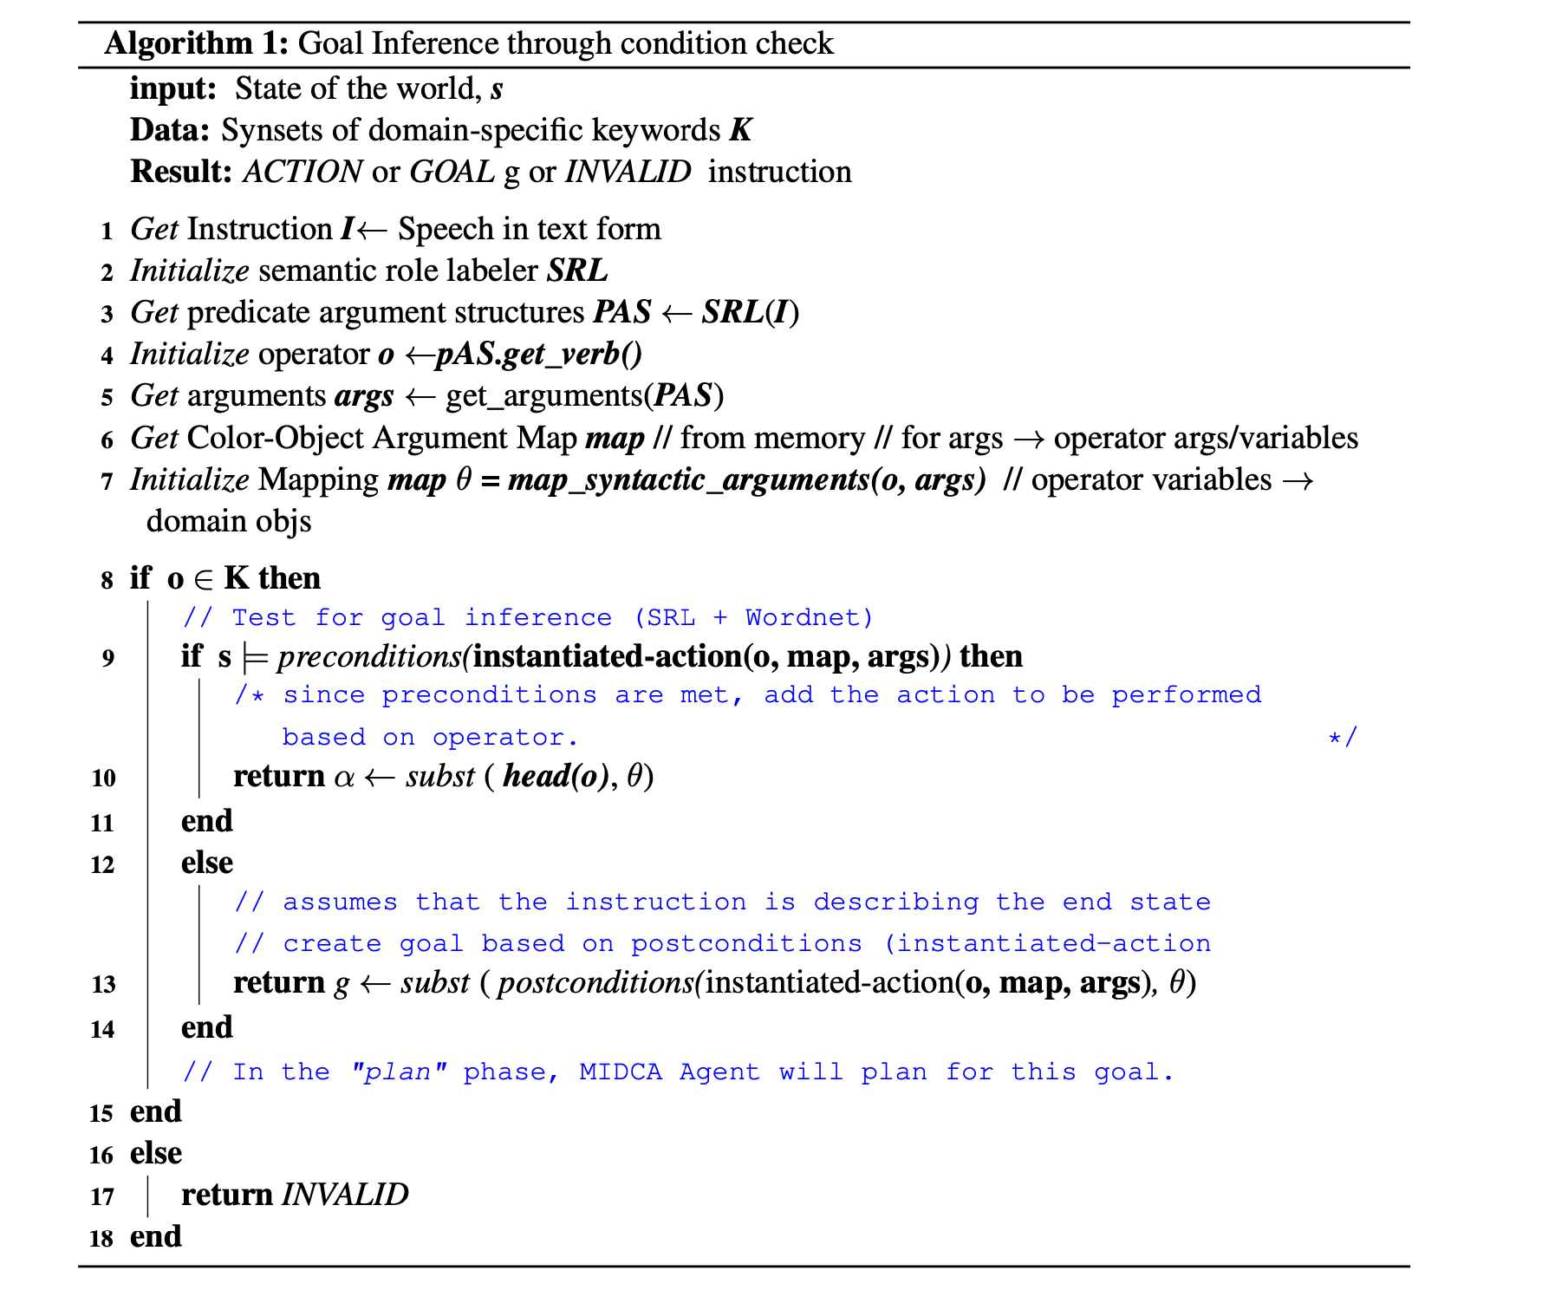
ACS 2020
#poster-gotteti
Inference through condition checks on instantiated actions
Dictionary that maps color of the block to their respective arguments.
E.g: red → A, blue → B
Domain Specific mapping is used to obtain instantiated action.
instantiated-action: stack(A,B)
An instantiated action (α) is an executable action if
Current state (s) satisfies preconditions defined on α
Otherwise, the agent assumes that user is describing a desired state.
The agent infers a goal on that described desired state/ postconditions over the extracted operator.
Once, the agent infers on performing on action or plan on achieving a goal, the remainder of MIDCA’s cognitive phases are carried out.
Towards Goal Inference for Human-Robot Collaboration
Notes:
Based on the person, elaborate on the slide.

Slide 6
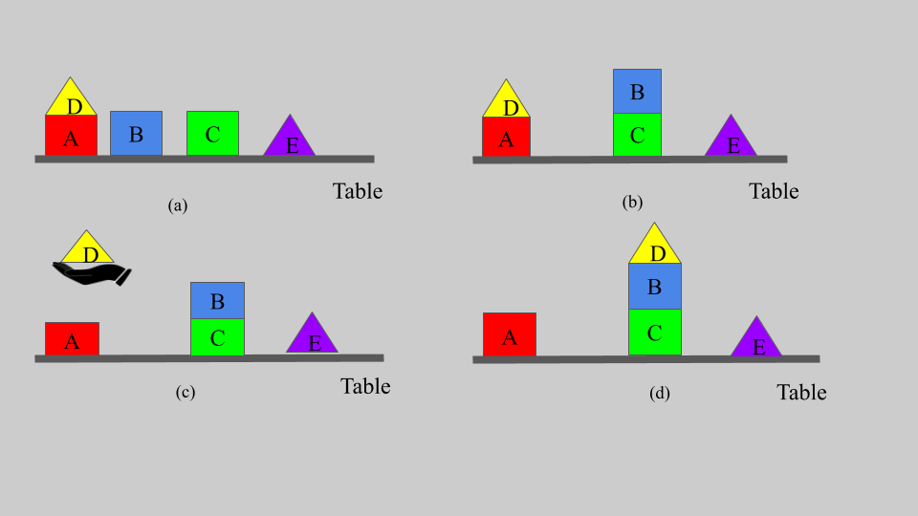
ACS 2020
#poster-gotteti
Usage Examples & Limitations
Ex 1: Please put the blue block on the green block.
PAS: V1 = please, args; V(domain-specific verb) = put
A1: blue block A2: green block
Domain-specific mapping: o: stack; objects: [blue,green]
Instantiated-action: stack(B,C) & Initial world = (a)
Check preconditions for stack(B,C): clear(C) ∧ holding(B)
// From (a) ‘C’ is clear but the agent is not holding ‘B’
// Since not all preconditions are met
// desired end state on operator/postconditions ‘B’ being on ‘C’ ⇒ we infer a goal of on (B, C)
Ex 2: Let the blue block be placed on the green block. Ex 3: Can the blue block be stacked on the green block? Ex 4: The yellow triangle is uncluttered from the red block.
Limitation (1): Doesn’t consider all possible goals Ex: Pick up the yellow triangle - holding(D) or on-table(D, false) or clear(A)
Limitation (2): Carried out limitations of SRL - Not trained on a particular domain. Ex: Put down the red block SRL-PAS: N/A - Not all extracted verb lead to a domain-specific verb. Ex: I want the red block in your hand -
(a) Initial state of the objects (blocks, triangles) in the construction domain, (b) State after executing the stacking goal on B (blue) block and C (green) block,
Towards Goal Inference for Human-Robot Collaboration
Notes:
Depending on the

Slide 7
ACS 2020
Discussion & Future work
#poster-gotteti
Novel approach to infer user intent through synonym generation, semantic role labeling, and inference through condition checks.
Demonstrated the effectiveness of the procedure using initial set of examples in terms of flexibility of sentences.
We plan to provide experimental evidence to our approach to evaluate the generality and improve user experience/satisfaction.
Limitations are caused by our commitment to accept free-form instructions rather rigid pre-scripted conversations.
Explore adding domain-specific knowledge graphs or ontologies to increase the accuracy of user intent inference.
Explore multiple possible goals for an utterance using probabilistic graph relational models of domain.
Questions(?)
Please click on this link for more information about this paper/poster.
Please forward any questions, concerns, and comments to GOTTETI.2@WRIGHT.EDU.
Towards Goal Inference for Human-Robot Collaboration
Notes:
Future work might not be needed for future research.

